Slide 1
Skip Lists
S₃
−∞
+∞
S₂
−∞
15
+∞
S₁
−∞
15
23
+∞
S₀
−∞
10
15
23
36
+∞
© 2013 Goodrich, Tamassia, Goldwasser
Skip Lists
Notes:
Skip Lists

Slide 2
What is a Skip List
A skip list for a set S of distinct (key, element) items is a series of lists S₀, S₁ , … , S_{h} such that
  Each list S_{i} contains the special keys +∞ and −∞
  List S₀ contains the keys of S in nondecreasing order
  Each list is a subsequence of the previous one, i.e.,
  S₀ ⊇ S₁ ⊇ … ⊇ S_{h}
  List S_{h} contains only the two special keys
We show how to use a skip list to implement the dictionary ADT
S₃
−∞
+∞
S₂
−∞
31
+∞
S₁
−∞
23
31
34
64
+∞
S₀
−∞
12
23
26
31
34
44
56
64
78
+∞
© 2013 Goodrich, Tamassia, Goldwasser
Skip Lists

Slide 3
Search
We search for a key x in a a skip list as follows:
  We start at the first position of the top list
  At the current position p, we compare x with y ← key(next(p))
  x = y: we return element(next(p))
  x > y: we “scan forward”
  x < y: we “drop down”
  If we try to drop down past the bottom list, we return null
Example: search for 78
S₃
−∞
+∞
scan forward
S₂
−∞
31
+∞
drop down
S₁
−∞
23
31
34
64
+∞
S₀
−∞
12
23
26
31
34
44
56
64
78
+∞
© 2013 Goodrich, Tamassia, Goldwasser
Skip Lists

Slide 4
Randomized Algorithms
A randomized algorithm performs coin tosses (i.e., uses random bits) to control its execution
It contains statements of the type
  b ← random()
  if b = 0
  do A …
  else { b = 1}
  do B …
Its running time depends on the outcomes of the coin tosses
We analyze the expected running time of a randomized algorithm under the following assumptions
  the coins are unbiased, and
  the coin tosses are independent
The worst-case running time of a randomized algorithm is often large but has very low probability (e.g., it occurs when all the coin tosses give “heads”)
We use a randomized algorithm to insert items into a skip list
© 2013 Goodrich, Tamassia, Goldwasser
Skip Lists
Notes:
Skip Lists

Slide 5
Insertion
To insert an entry (x, o) into a skip list, we use a randomized algorithm:
  We repeatedly toss a coin until we get tails, and we denote with i the number of times the coin came up heads
  If i ≥ h, we add to the skip list new lists S_{h+1}, … , S_{i +1}, each containing only the two special keys
  We search for x in the skip list and find the positions p₀, p₁ , …, p_{i} of the items with largest key less than x in each list S₀, S₁, … , S_{i}
  For j ← 0, …, i, we insert item (x, o) into list S_{j} after position p_{j}
Example: insert key 15, with i = 2
S₃
−∞
+∞
p₂
S₂
−∞
+∞
S₂
−∞
15
+∞
p₁
S₁
−∞
23
+∞
S₁
−∞
15
23
+∞
p₀
S₀
−∞
10
23
36
+∞
S₀
−∞
10
15
23
36
+∞
© 2013 Goodrich, Tamassia, Goldwasser
Skip Lists

Slide 6
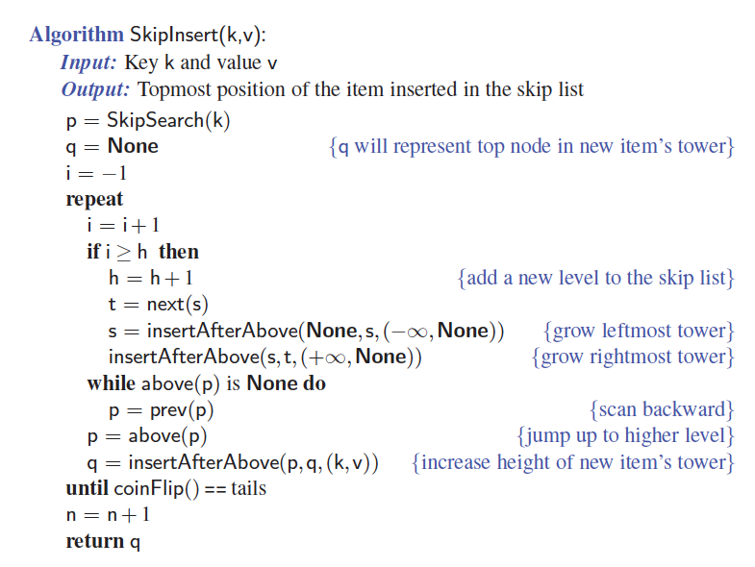
Insertion Pseudo-code
© 2013 Goodrich, Tamassia, Goldwasser
Skip Lists

Slide 7
Deletion
To remove an entry with key x from a skip list, we proceed as follows:
  We search for x in the skip list and find the positions p₀, p₁ , …, p_{i} of the items with key x, where position p_{j} is in list S_{j}
  We remove positions p₀, p₁ , …, p_{i} from the lists S₀, S₁, … , S_{i}
  We remove all but one list containing only the two special keys
Example: remove key 34
S₃
−∞
+∞
p₂
S₂
−∞
34
+∞
S₂
−∞
+∞
p₁
S₁
−∞
23
34
+∞
S₁
−∞
23
+∞
p₀
S₀
−∞
12
23
34
45
+∞
S₀
−∞
12
23
45
+∞
© 2013 Goodrich, Tamassia, Goldwasser
Skip Lists

Slide 8
Implementation
We can implement a skip list with quad-nodes
A quad-node stores:
  entry
  link to the node prev
  link to the node next
  link to the node below
  link to the node above
Also, we define special keys PLUS_INF and MINUS_INF, and we modify the key comparator to handle them
quad-node
x
© 2013 Goodrich, Tamassia, Goldwasser
Skip Lists

Slide 9
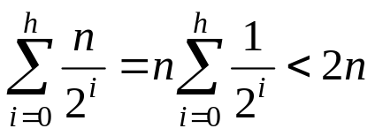
Space Usage
Consider a skip list with n entries
  By Fact 1, we insert an entry in list S_{i} with probability 1/2^{i}
  By Fact 2, the expected size of list S_{i} is n/2^{i}
The expected number of nodes used by the skip list is
The space used by a skip list depends on the random bits used by each invocation of the insertion algorithm
We use the following two basic probabilistic facts:
  Fact 1: The probability of getting i consecutive heads when flipping a coin is 1/2^{i}
  Fact 2: If each of n entries is present in a set with probability p, the expected size of the set is np
Thus, the expected space usage of a skip list with n items is O(n)
© 2013 Goodrich, Tamassia, Goldwasser
Skip Lists

Slide 10
Height
The running time of the search an insertion algorithms is affected by the height h of the skip list
We show that with high probability, a skip list with n items has height O(log n)
We use the following additional probabilistic fact:
  Fact 3: If each of n events has probability p, the probability that at least one event occurs is at most np
Consider a skip list with n entires
  By Fact 1, we insert an entry in list S_{i} with probability 1/2^{i}
  By Fact 3, the probability that list S_{i} has at least one item is at most n/2^{i}
By picking i = 3log n, we have that the probability that S_{3log n} has at least one entry is
at most
n/2^{3log n} = n/n³ = 1/n²
Thus a skip list with n entries has height at most 3log n with probability at least 1 − 1/n²
© 2013 Goodrich, Tamassia, Goldwasser
Skip Lists

Slide 11
Search and Update Times
The search time in a skip list is proportional to
  the number of drop-down steps, plus
  the number of scan-forward steps
The drop-down steps are bounded by the height of the skip list and thus are O(log n) with high probability
To analyze the scan-forward steps, we use yet another probabilistic fact:
  Fact 4: The expected number of coin tosses required in order to get tails is 2
When we scan forward in a list, the destination key does not belong to a higher list
  A scan-forward step is associated with a former coin toss that gave tails
By Fact 4, in each list the expected number of scan-forward steps is 2
Thus, the expected number of scan-forward steps is O(log n)
We conclude that a search in a skip list takes O(log n) expected time
The analysis of insertion and deletion gives similar results
© 2013 Goodrich, Tamassia, Goldwasser
Skip Lists

Slide 12
Summary
A skip list is a data structure for dictionaries that uses a randomized insertion algorithm
In a skip list with n entries
  The expected space used is O(n)
  The expected search, insertion and deletion time is O(log n)
Using a more complex probabilistic analysis, one can show that these performance bounds also hold with high probability
Skip lists are fast and simple to implement in practice
© 2013 Goodrich, Tamassia, Goldwasser
Skip Lists

